Slide 1
Car-Coopers: A customized automobile manufacturer
Final Project by
Shruti
Sonali
Raksha

Slide 2
Problem Statement
Customers can customize their cars or choose from the list of already manufactured cars
Automobile companies(like Hyundai, Tesla) can request for the manufacture of their pre-designed cars
EPA is a regulatory body which keeps a check on how much the manufacturing companies are contributing to control hazardous content

Slide 3
More about Car Coopers
Customers can customize their cars based on a lot of factors(engine, wheels)
Customers can also choose from pre-designed cars in the showroom
Car companies place requests for selling of their models to showrooms

Slide 4
Business model
Car Cooper Enterprise
Belongs to
Ecosystem
Customer Orders
Customer Support
Belongs to
Car Company Orders
Car Enterprise
Belongs to
Regulatory Enterprise
Belongs to

Slide 5
Object Model

Slide 6
Customer Support Enterprise

Slide 7
Car Company Enterprise

Slide 8
Car Cooper Enterprise

Slide 9
Regulatory Enterprise

Slide 10
Users
Customers
Car Company Clients
Employees

Slide 11
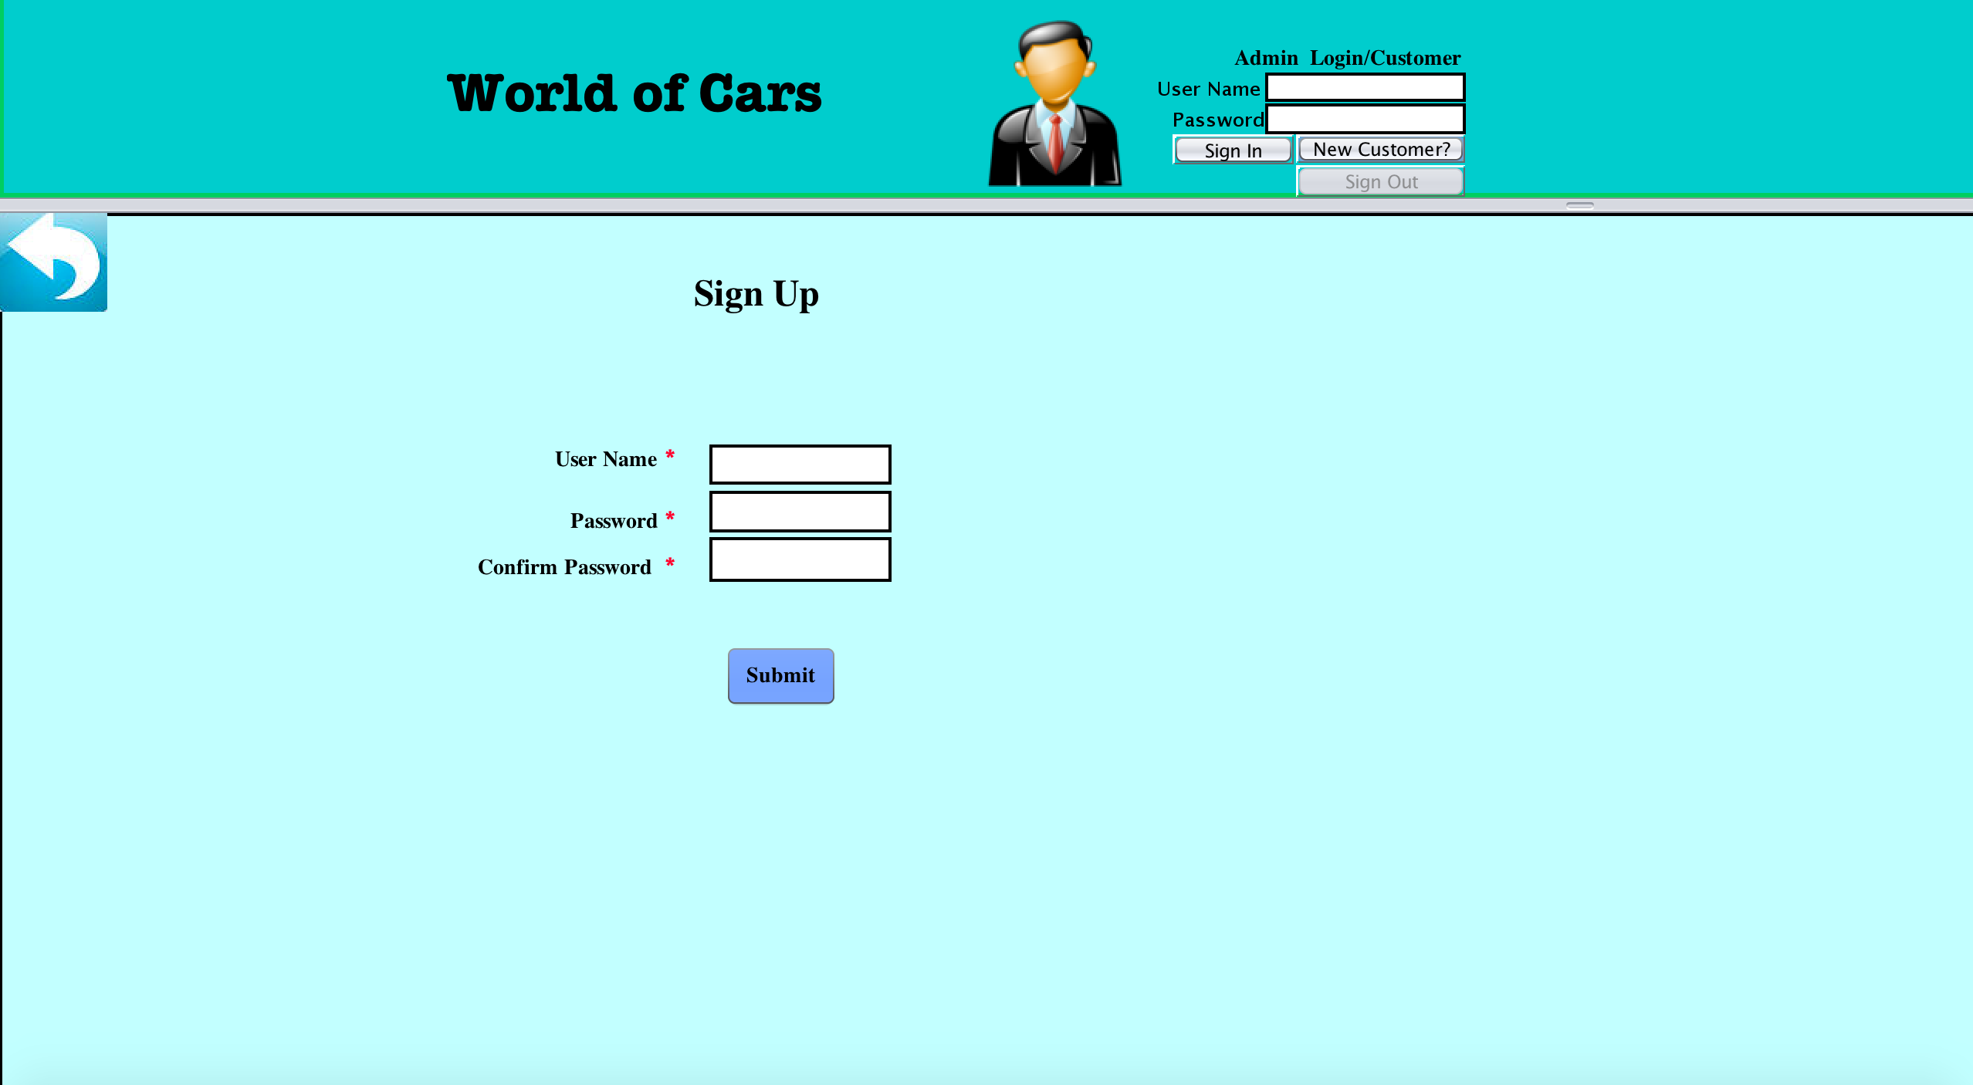
Customer as User

Slide 12
Customer
Buy At Store
Customize Car

Slide 13
Customized Order
Customize Car
(Order Item)
Customer
Customized Order
Customized Order List

Slide 14
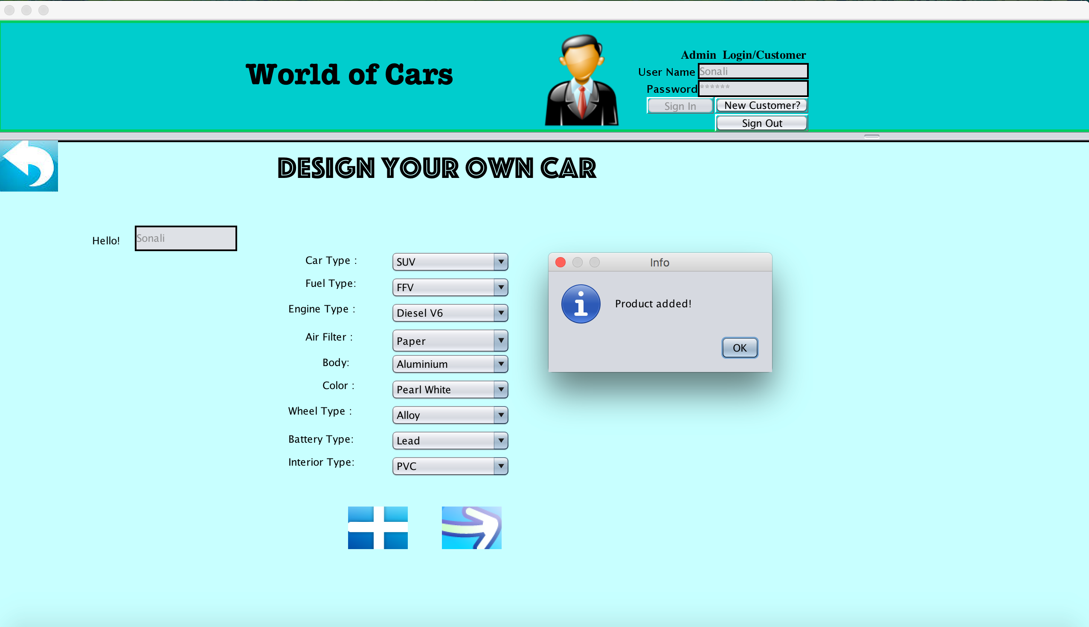

Slide 15
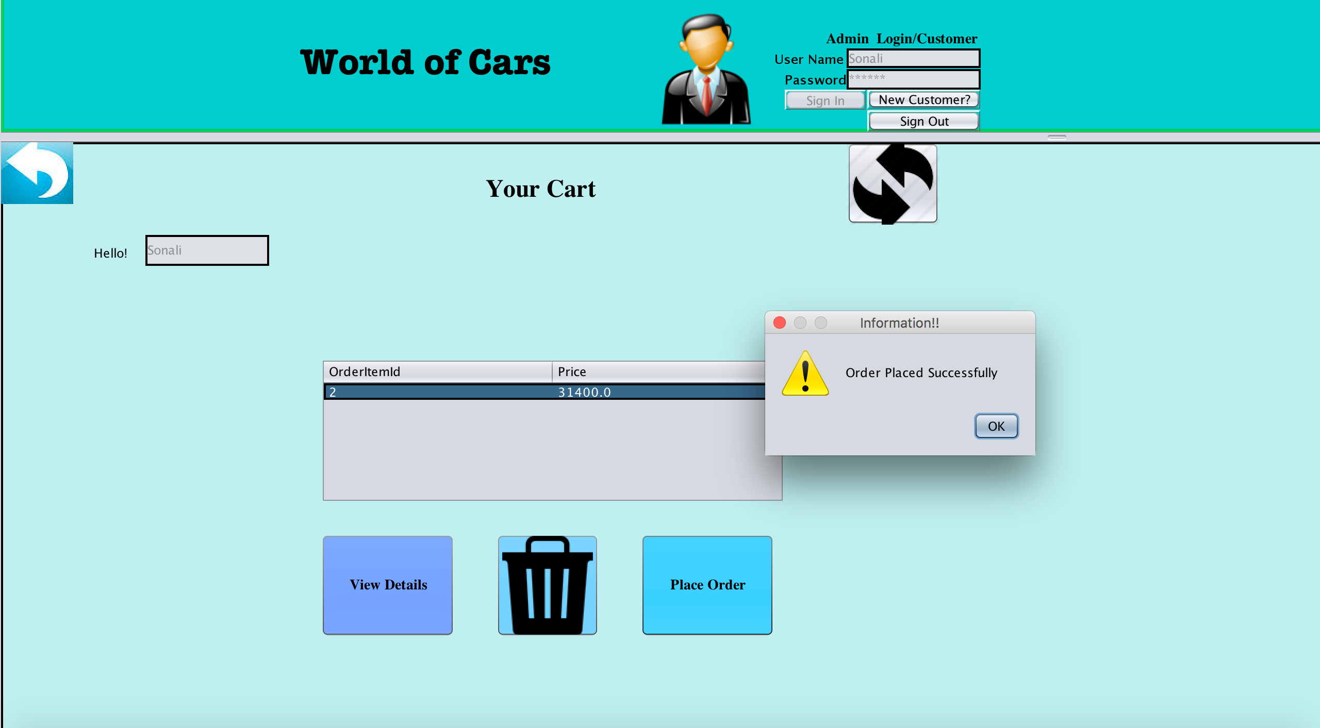

Slide 16
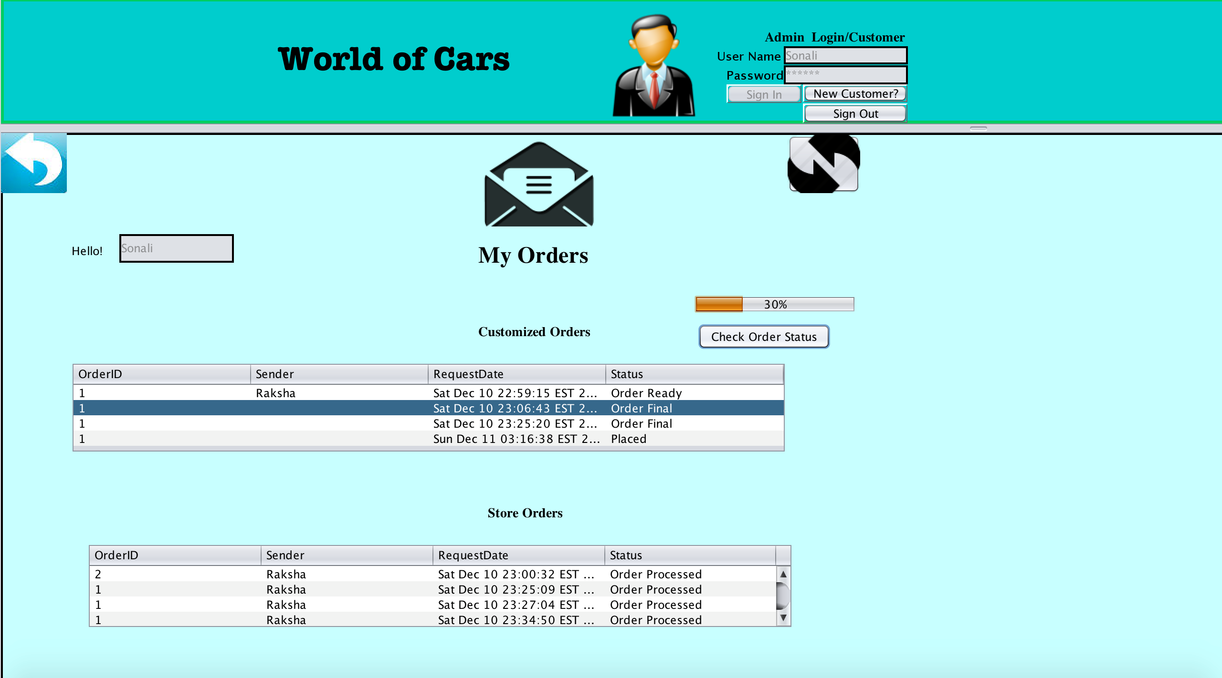
Customer Order Requests

Slide 17
Buy At Store Orders
Customer
Store Order item
Store Order
Store Order List

Slide 18
Customized Order List
Master Order List
Store Order List

Slide 19
Car Company sale Requests
Car Company Login
Create
Car Catalog
Car sale request
Store

Slide 20
Work Request
Customized Order Work Request
Buy at store Work Request
Car Company Sale Work Request
Inventory Work Request
Regulatory Work Request

Slide 21
Customized Order Work Request and Inventory Work Request
Customer
Customize Product
Customized Order
Store Organization
Customer Order Requests
Design Organization
Manufacture Organization
Inventory Organization

Slide 22
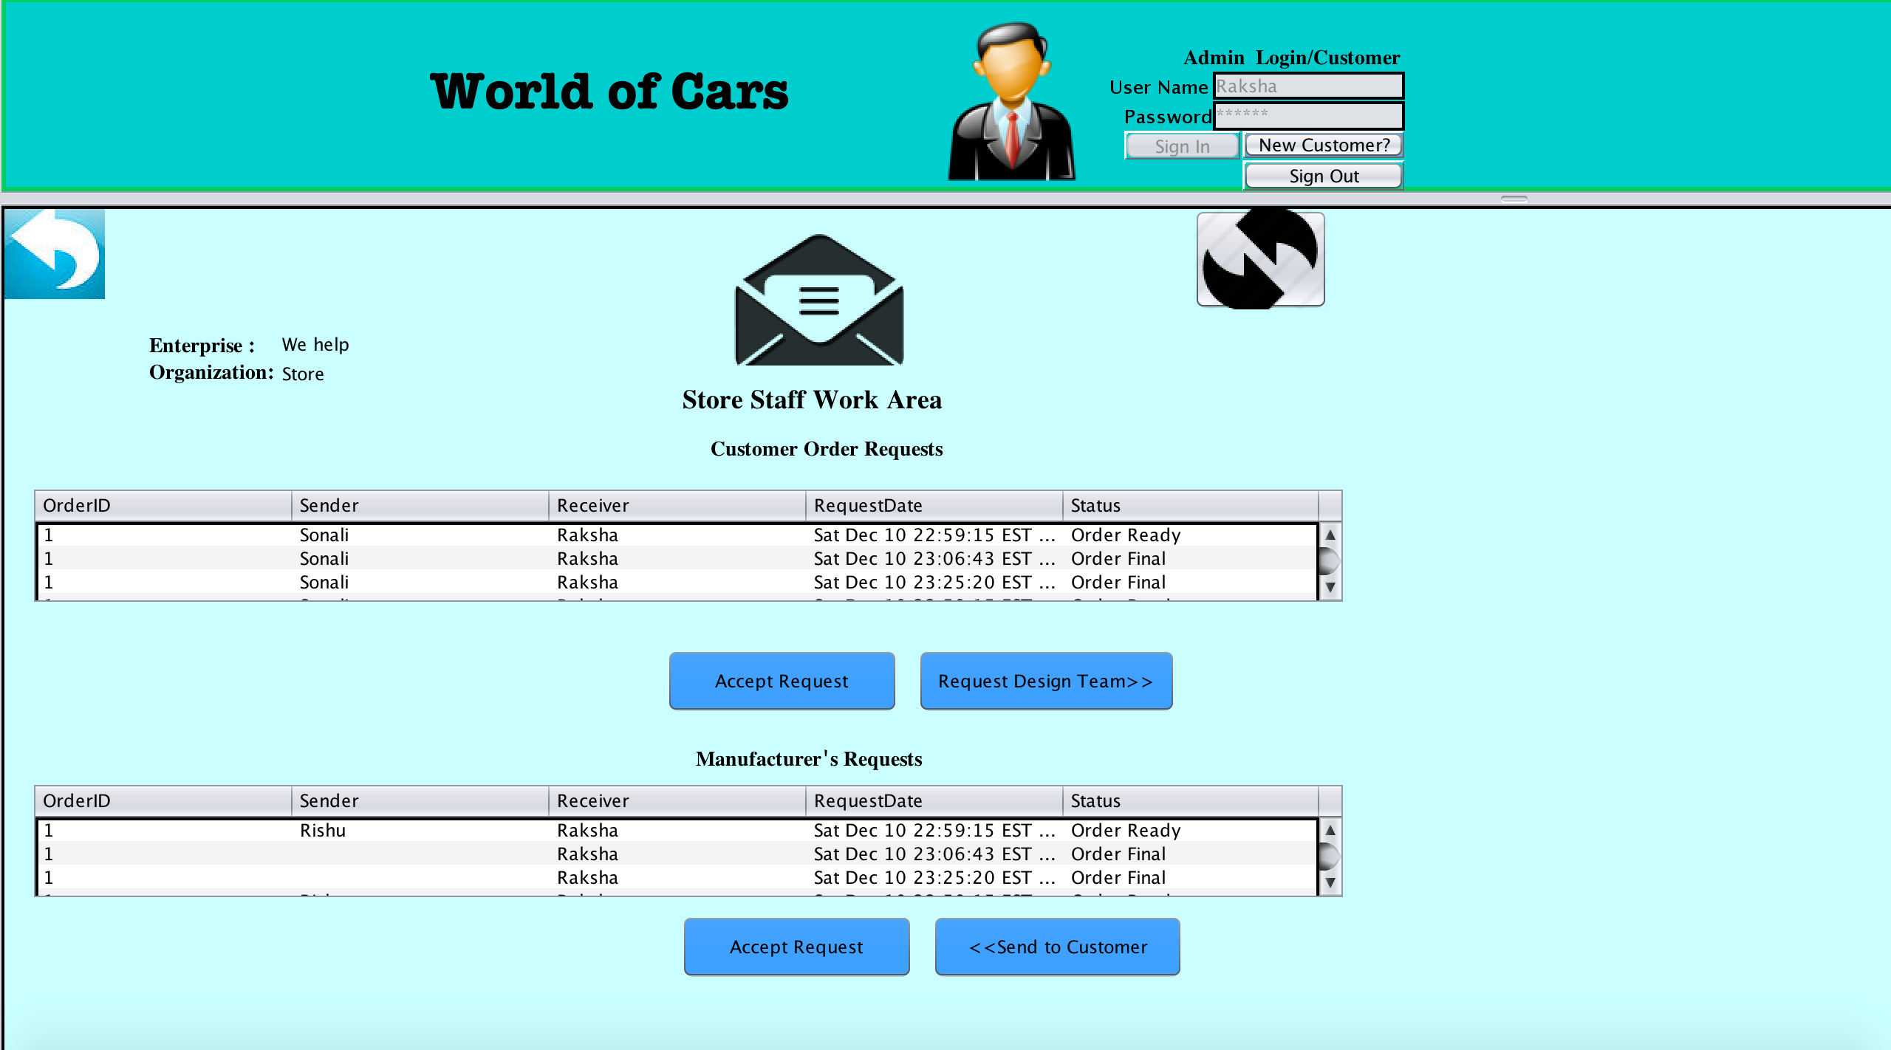
Customer Requests in Store

Slide 23
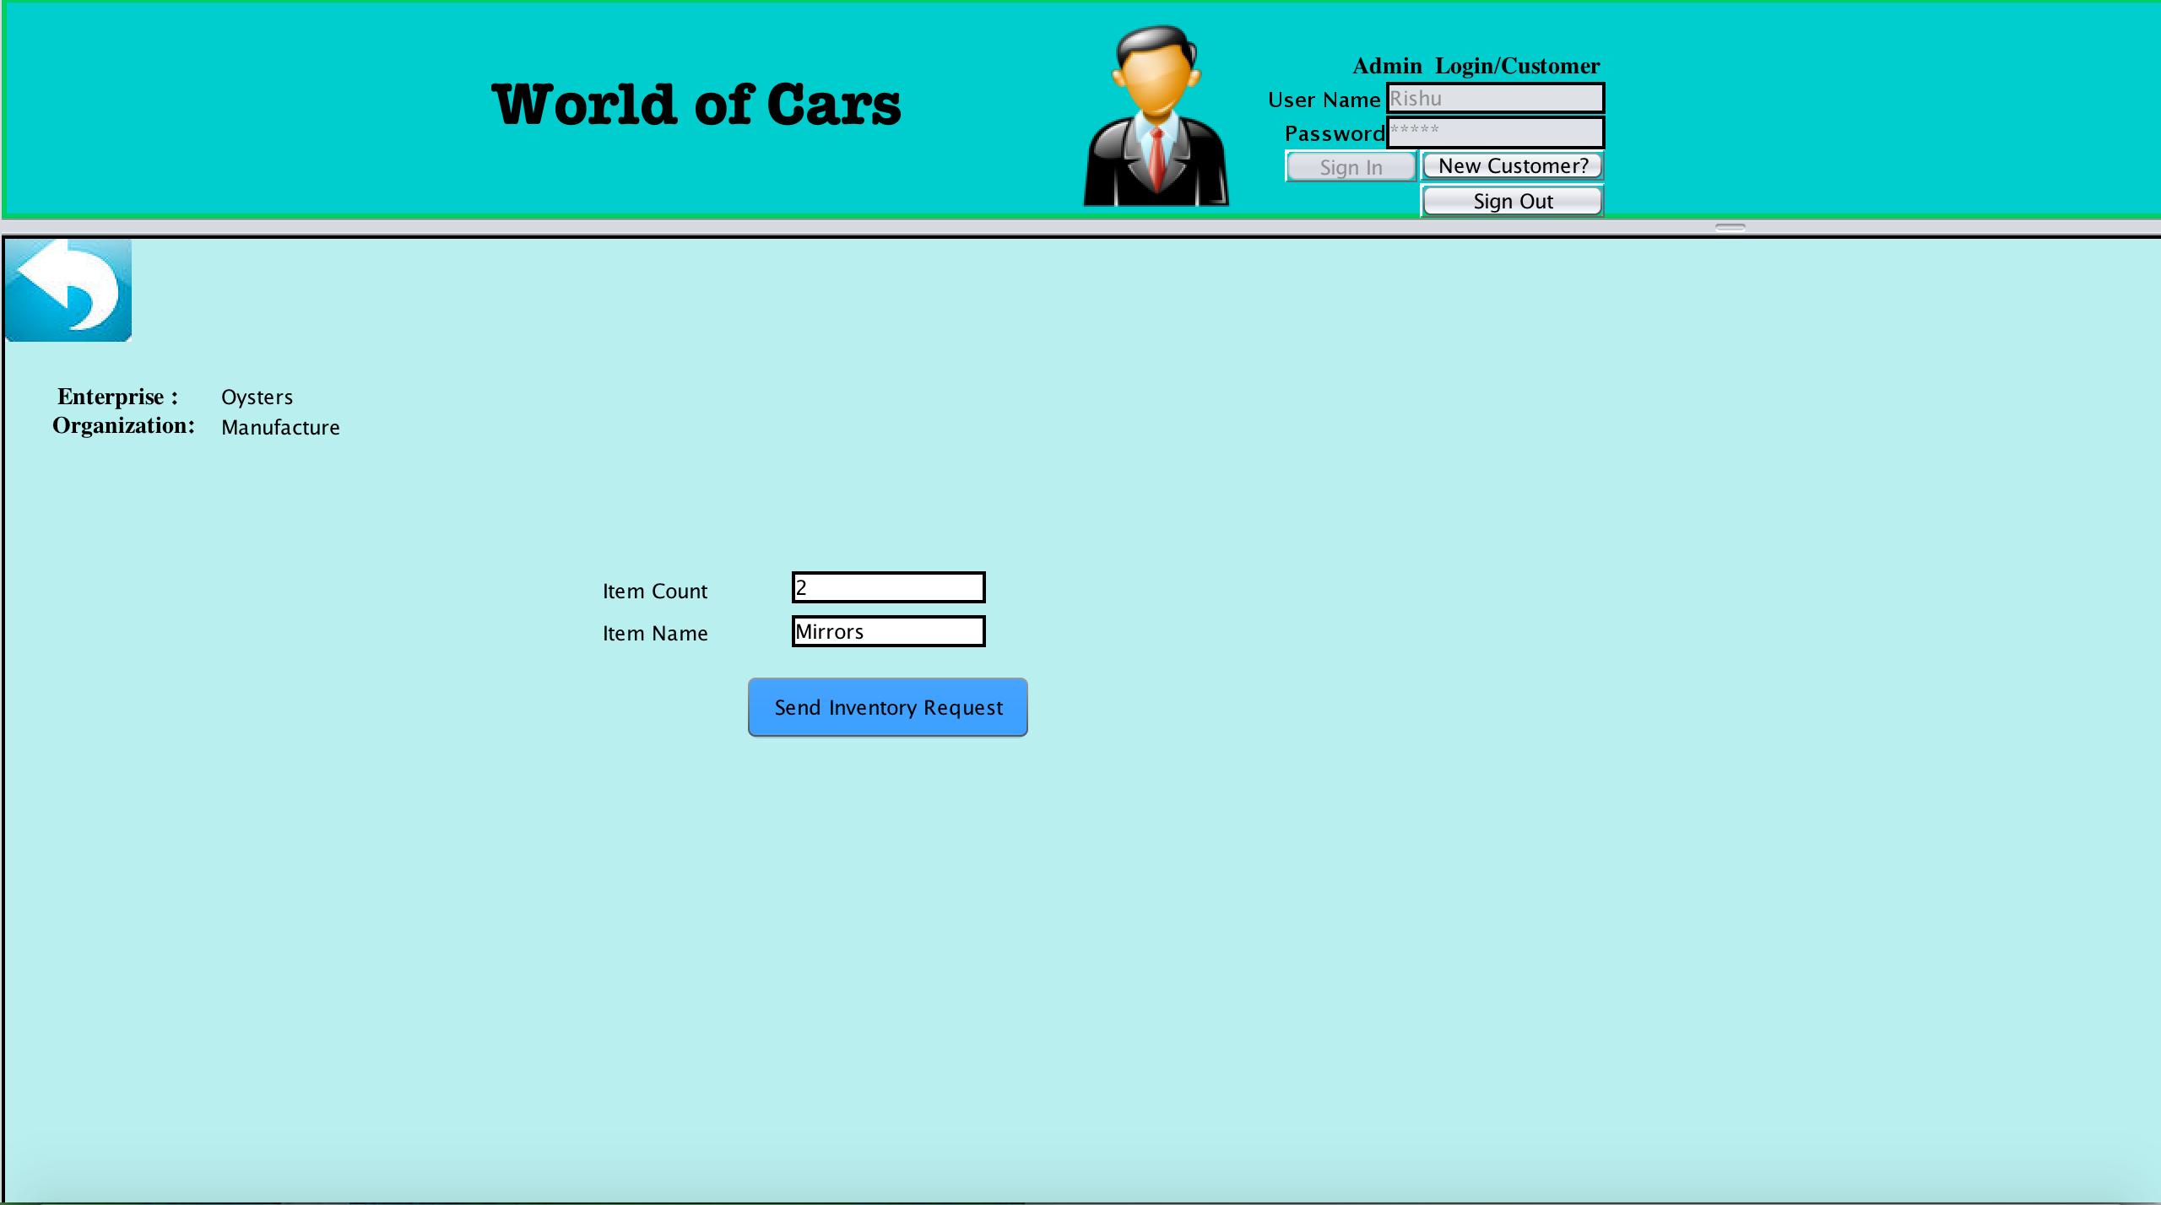
Request to Inventory

Slide 24
Buy at store Work Request
Customer
Buy at Store Product
Customer Store Order Requests
Store Organization

Slide 25
Car Company Work Request
Car Catalog
Car sale request
Store Organization

Slide 26
Regulatory Work Request
Quality check Organization
Request Report
Reporting Organization
Download..

Slide 27
Thank You

